Slide 1
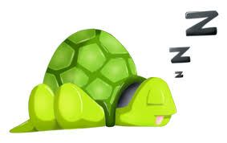
Milestone 1
Team Nocturnal KnockTurtle
Jackie Floyd, Sam Pollinger, Ria Shroff,
Andrew Travis, Maeve Tucker, Shiyan Yang
Notes:
Shiyan, Introduce ourselves
It’s like a turtle because it’s a slow wake system kind of
And knocking is a sound. And sounds are vibrations.
Therefore, we are Nocturnal KnockTurtle.
Also: https://www.amazon.com/Knock-Turtle-Adventures-Lamb/dp/1439227977

Slide 2
Agenda
Problem Definition
Solution
Benchmarking
Customer Requirements
Performance Specification
Subsystems
Test/Analysis
Notes:
Shiyan

Slide 3
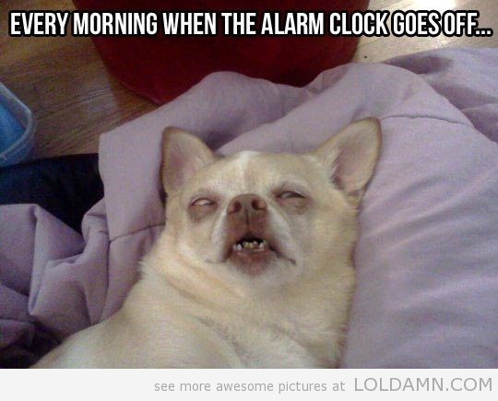
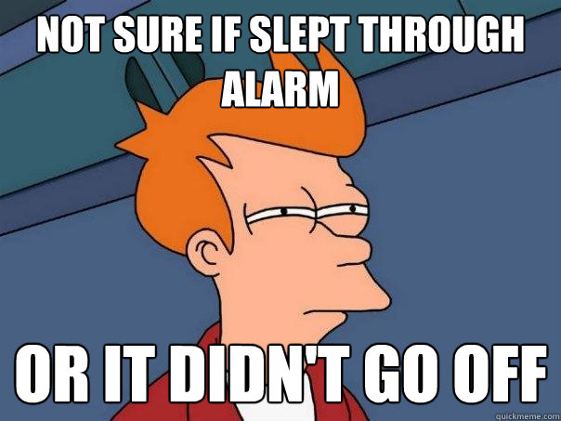
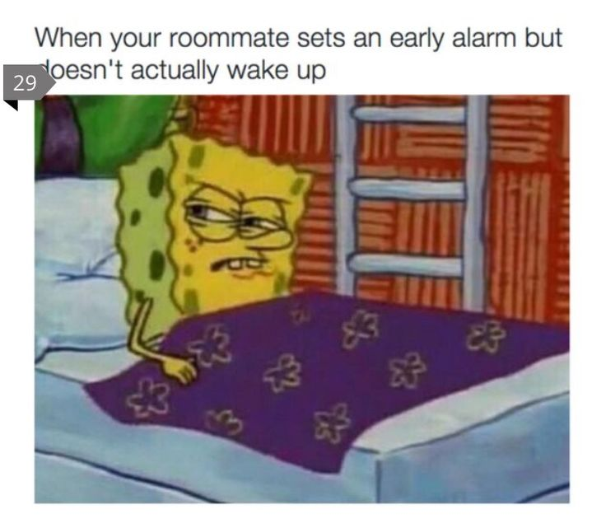
Problem Definition
To design an alarm clock that effectively wakes the user without waking others in their vicinity.
Notes:
It must not be able to accidentally switch off/ignore, must not wake roommate, and potentially make waking up in the morning less jarring

Slide 4
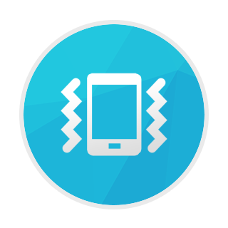
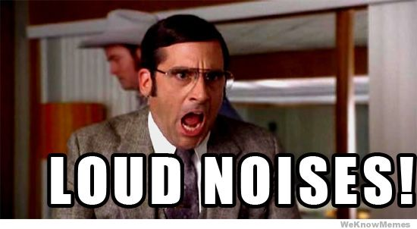

Solution
Avoid Loud Noises
Two options
Light
Vibration
Notes:
Andrew
Play the alarm noise
Have someone by door flick lights on for a brief second maybe?

Slide 5
Benchmarking
Research existing vibrating alarm clocks on the market
Determine what did and did not fit in with our problem statement
Look at reviews of existing products to find out what could be improved
Notes:
Jackie
When we came up with our idea, one of the first things we did was research to see what was already on the market. We found products that had similar concepts, but none of them fit exactly what we were trying to achieve for our customer base. We looked at reviews of the already existing products to see what issues customers had with them, and thought about how we could improve those features while also adding new features to solve our problem statement.

Slide 6
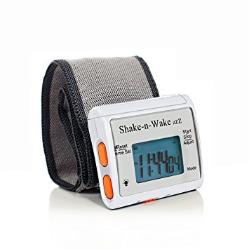
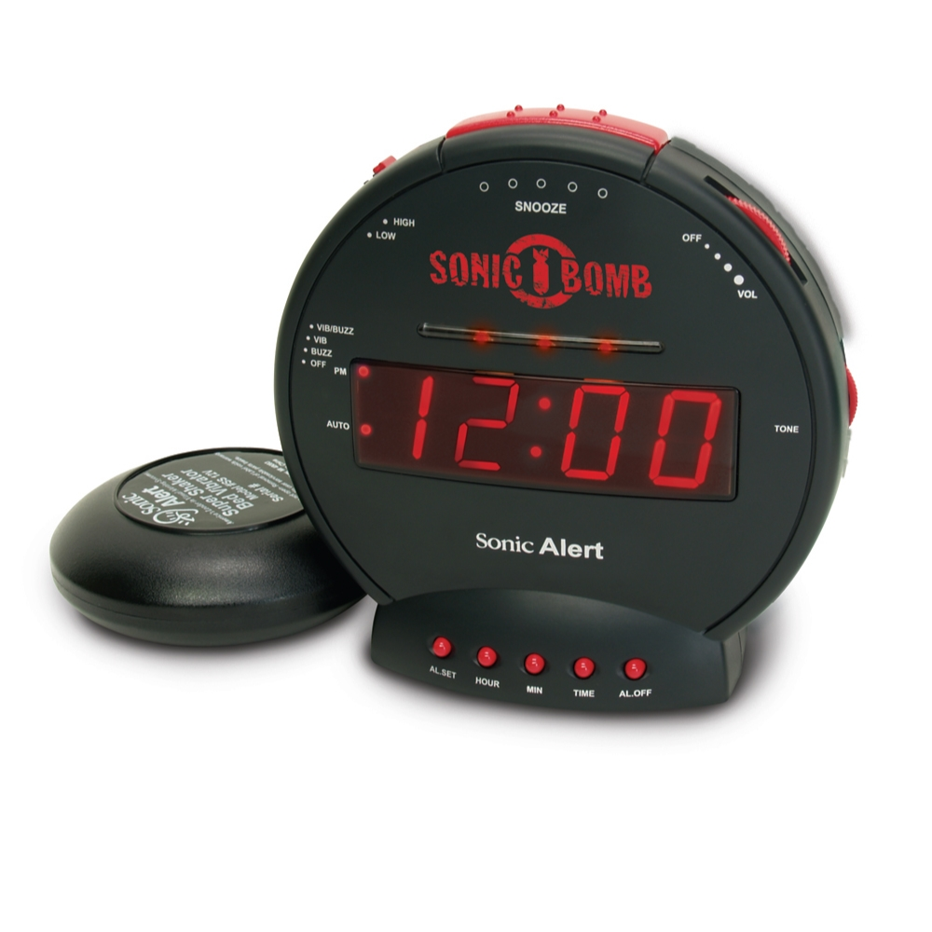
Existing products:
“Shake-N-Wake” [1]
Sonic Bomb [2]
Notes:
Some of the products we found were a wristband that vibrates to wake you up, but we didn't like how the buttons were on the band and could easily be accidentally pressed in your sleep. We also found one that has a vibrating component that goes under your pillow, but the reviews stated that the vibrations were very subtle and could barely be felt, and it also had an extremely loud alarm to accompany them, which does not fit in with the problem we were trying to solve.
Some versions of these used bluetooth or batteries which proved to be unreliable.

Slide 7
Customer Requirements
Notes:
Maeve
From the benchmarking, we decided to collect customer information to determine the optimal product for our specific audience.

Slide 8
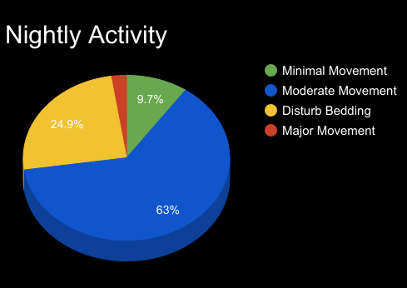
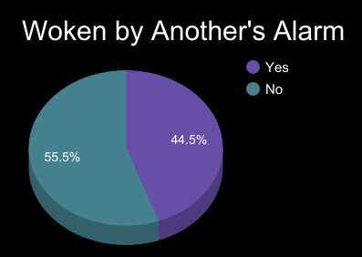
Audience
College students
Shared rooms
Moderate sleepers
Most use a fitted sheet
Notes:
Maeve
The first thing we did to define customer requirements was identify our target audience. For our project, we chose the audience to be our fellow college students. We created a brief survey to explore sleep and waking habits of our customers.
This is the “typical” student who is a moderate sleeper, shifts in their sleep occasionally, and is living with others.
Note that of the applicable responses, almost 50% said they are usually woken by their roommates’ alarm(s). This is part of the main problem we want to eliminate.

Slide 9
Performance Specifications
Eliminate possibility of accidentally hitting buttons in sleep
Hard-wired (batteries won’t die)
No reliance on phone being charged or bluetooth
Pad secured under fitted sheet
Comfort, no trying to sleep on an alarm clock strapped to your wrist
Won’t fall off/to floor
Vibration located where you will be laying (accounts for some shifting during sleep)
Embedded speakers will provide an option of potential sleep aid through white noise and music
Morning Pattern: gentle vibration → harder vibration → speakers
Notes:
Ria

Slide 10
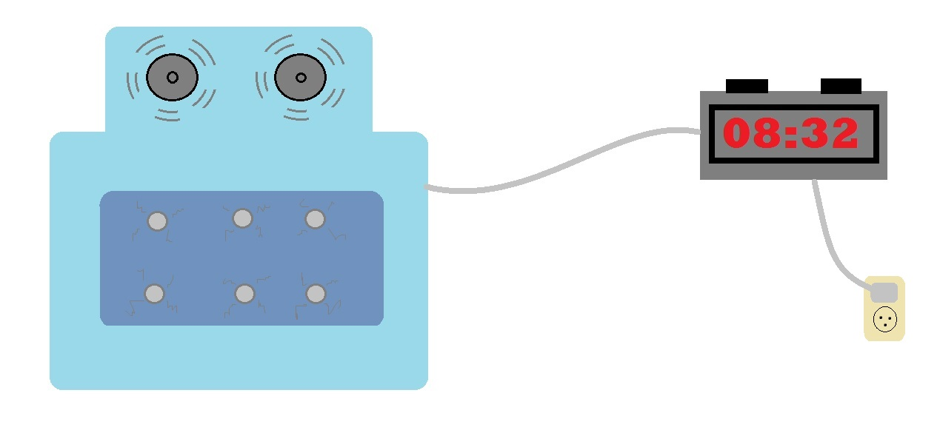
Project Concept

Slide 11
Subsystems
Alarm Clock Casing- Design and construction of the outer casing of the alarm clock.
Vibrations- Installation of vibration motors into the pad.
Speakers- Selection and installation of speakers into the pad.
Notes:
Sam

Slide 12
Subsystems
Safety- Selection of fire resistant and waterproof materials to prevent safety hazards.
Power and Wiring- Installation of power cords, battery backup, and connecting the clock to the pad.
Electrical and Circuit Integration- Wiring of circuit boards, integration of speakers, vibrating motors and clock.

Slide 13
Test/Analysis
Test individual subsystem robustness and safety of overall device through repeated use
Trial with 10 RPI students with shared room
Test with extreme subjects (heavy and light sleepers)
Standardize the trial:
Participants should have similar sleeping schedule
Participants should not be overly tired
No caffeine intake
Notes:
Shiyan
The last slide(s) need to be presented as the conclusion without blatantly saying it

Slide 14
Resources
[1] “Shake-N-Wake” https://www.amazon.com/Silent-Vibrating-Personal-Alarm-Shake-N-Wake/dp/B0027A573Q/ref=pd_sim_121_1?_encoding=UTF8&psc=1&refRID=T0DQ26H4NMSYYMXNCB74
[2] Sonic Bomb https://www.amazon.com/Sonic-Alert-SBB500SS-Alarm-Shaker/dp/B000OOWZUK

Slide 15
Questions?

